Slide 1
Lean Six Sigma Case Study - Gentech
Business Process Analytics
Ayush Trivedi, Lakshmi Sarva, Miao Zheng, S Shujahat Ali

Slide 2
Table of Content
Company Overview and Situation
Project Charter
Process Map
Quantitative Analysis
Qualitative Analysis
Recommendations

Slide 3
Company Overview and Situation
$ 60 Billion Revenue
18% Reduction in Revenue
150,000 Employees
5
5 Geographies
Sellers/Geo
5 Brands
4 BSS

Slide 4
Project Charter
Streamlining the Proposal Creation Process at Gentech
Business Problem: Overcome revenue loss of 18% by reducing cycle time | Executive Sponsor Eliot Smith, CEO Grace Monroe, VP Black Belt Champion Jeff Hugh, LSS
Objective and Scope Objective:The emphasis is on analysing previous transaction data to reduce delays, optimise cycle time, and achieve a defect rate of 3.4 per million opportunities. Best practices will be shared internationally to ensure uniform performance. Scope: The project will review global proposal creation processes across teams, brands, and geographies. It will identify bottlenecks, optimize hand-offs, and streamline approvals to improve ROI once implemented.
 | Team Members Sellers Bid Support Staff (BSS) Pricing Team Proposal Support Manager
DMAIC | Plan Start – Plan End | Operational Metric | Baseline | Target
Define | 11/10 – 11/13 | Cycle time, Bid size Cycle time to Bid Size Ratio | Median Cycle time | Reducing cycle time of operations by 15%
Measure | 11/14 – 11/18
Analyze | 11/19 – 11/29 | Expected Benefits: $90 million in savings and more time to additional bids |  | Projected Savings
Improve | 11/30 – 12/05 | Hard Benefits: Increased revenue, improved efficiency Soft Benefits: More bids, customer retention Strategic Benefits: Company growth due to large customer (Scalable) |  | $90 million
Control | 12/06 – 12/10

Slide 5

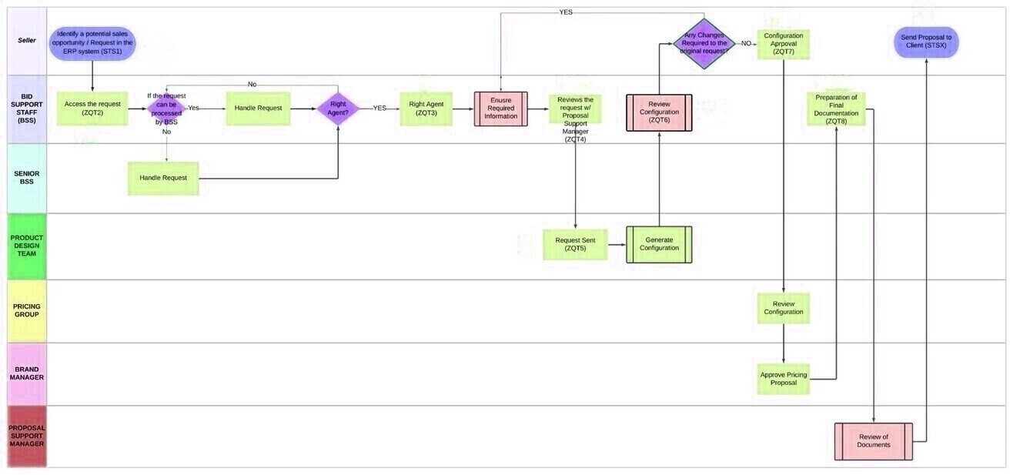
Process Map
2.0
1.9
3.1
3.6
6.5
7.4
2.0
3.1
2.0

Slide 7
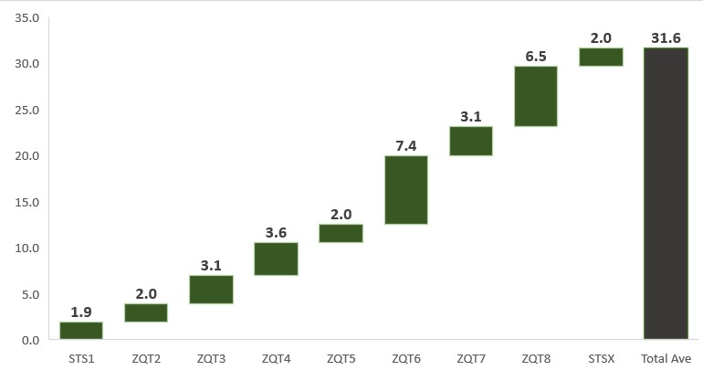
Average Time For Each Step
Stage | Root Cause
ZQT6 (Configuration Review) | Incomplete initial configurations due to missing information from Seller
 | Feedback loops causing repeated revisions
ZQT8 (Document Preparation) | Non-standard documentation causing delays
 | Multiple approvals from Brand Managers, even for low-value deals
Average Time Taken
Timestamps
ZQT6 (Configuration Review) and ZQT8 (Document Preparation) have significantly longer average times compared to other stages, indicating potential bottlenecks.

Slide 8
Strategic Improvements and Anticipated Benefits
Proposed Solutions
Expected Impacts
Stage | Solution
ZQT6 (Configuration Review) | Implement a pre-review checklist
 | Automate configuration validation
 | Enhance cross-functional collaboration
 | Use version control for configuration documents
ZQT8 (Document Preparation) | Standardize document templates
 | Streamline approval processes
 | Utilize workflow automation tools
 | Establish SLAs and provide team training
Area | Impact
Cycle Time Reduction | Faster turnaround by streamlining reviews and approvals
Improved Accuracy | Reduced rework through better initial checks and validation
Increased Efficiency | Eliminated bottlenecks with standardized procedures
Enhanced Collaboration | Better team coordination through sync-ups and training

Slide 9
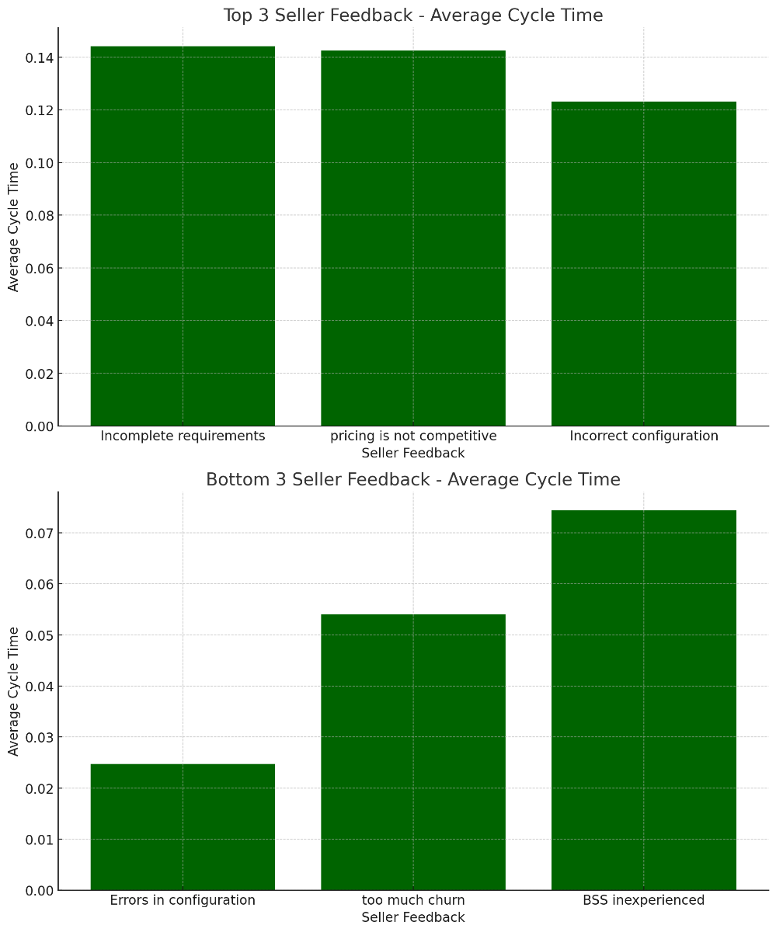
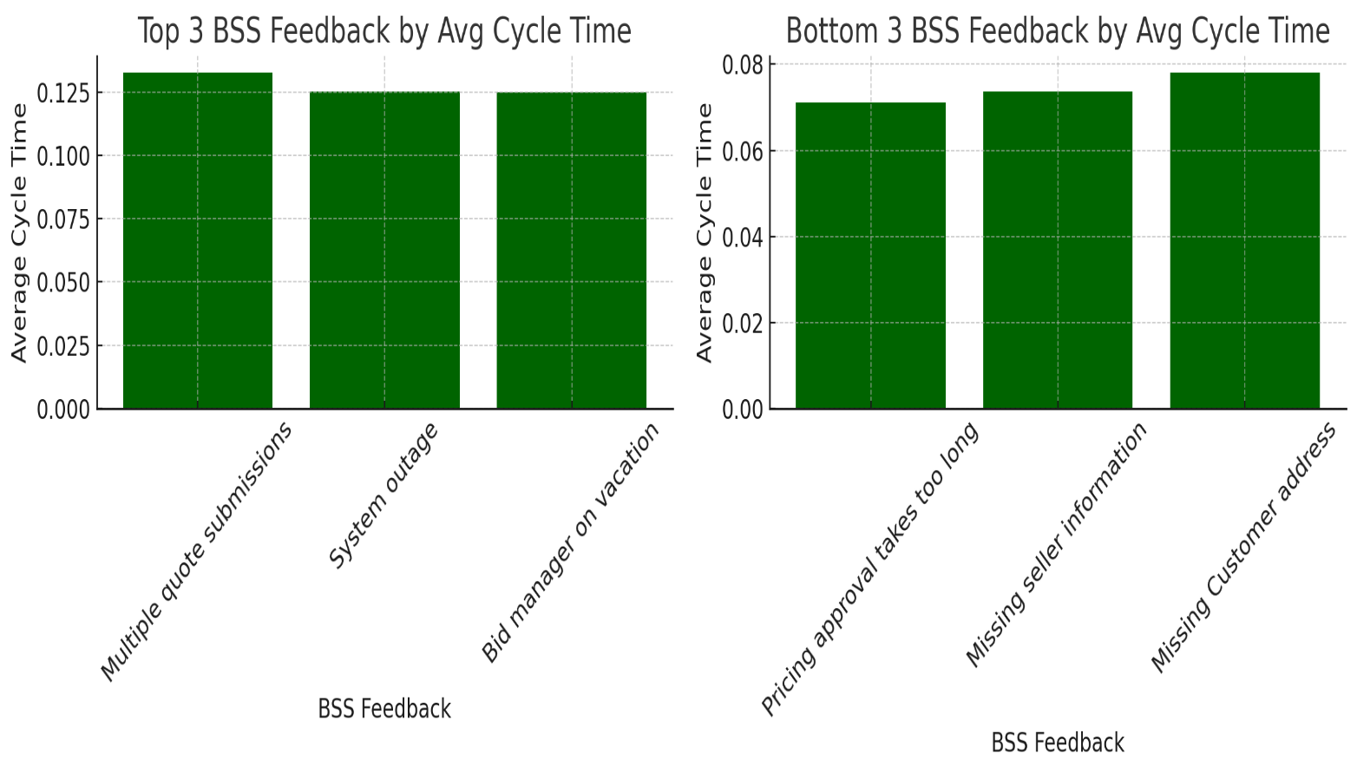
Comparative Performance of BSS and Sellers

Slide 10
Comparison of SLA, DPMO and Sigma Level
21,079 Number of Defects
75,000 Opportunities for Errors
281,053.3
DPMO
2.08
Sigma Level
28.1% of the Transactions take longer than 35 Days

Slide 11
Brands and their Average Cycle Times
Most Efficient Region
Japan (27 Days)
Longest Delay
North America (35.97 Days)
Similar Cycle Times
AP, EMEA and SA (~30 Days)
Benchmark for Best Practices
JPN

Slide 12
Correlation between bid complexity and cycle time
0.83 Correlation between Bid Complexity and Cycle Time Strong Positive Relationship
Generally, Larger Bids require larger times
Process Segmentation based on Bid Size

Slide 14
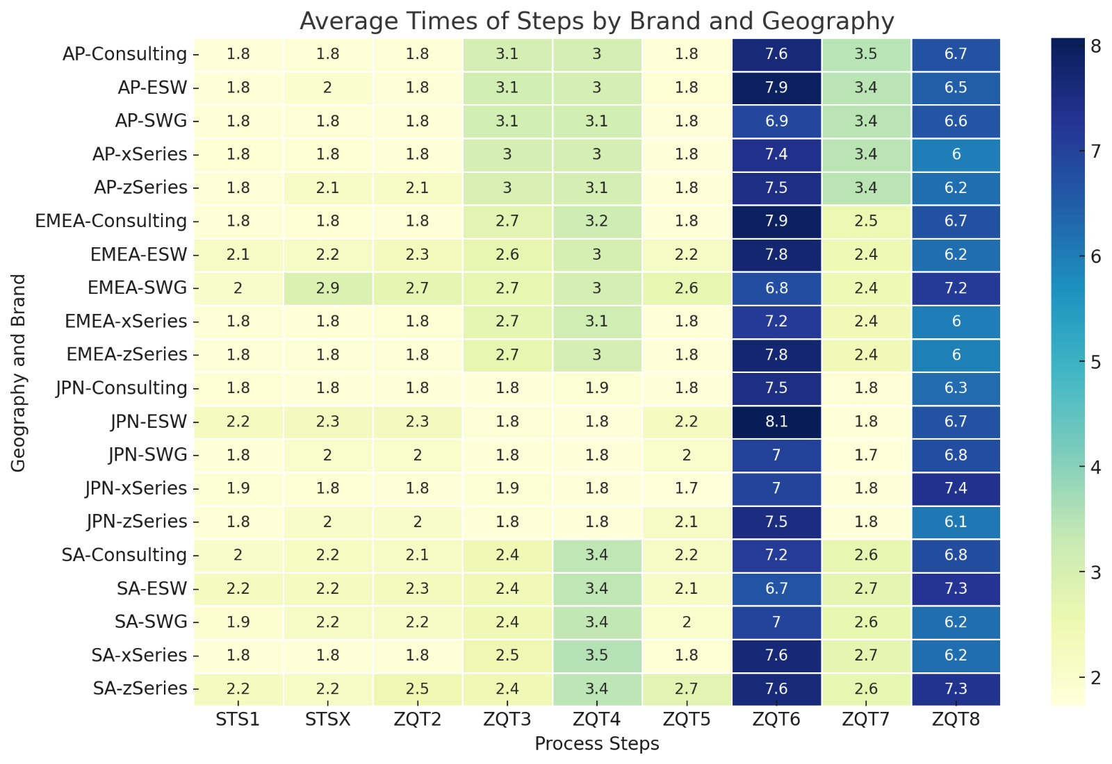
Average Times across Brands and Geographies
Japan has the lowest of Cycle Times and NA America has the highest
Xseries has the highest Cycle time and Consulting has the lowest

Slide 15
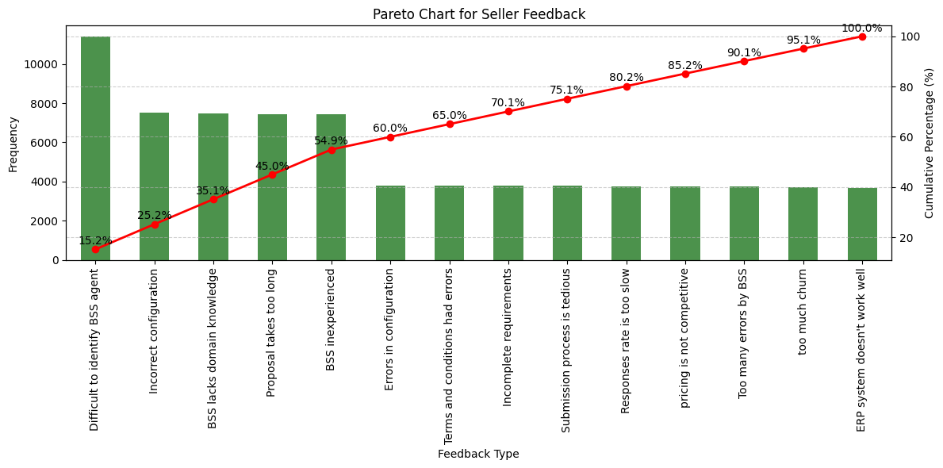
Pareto Chart for Sellers: Too Many BSS Issues

Slide 16
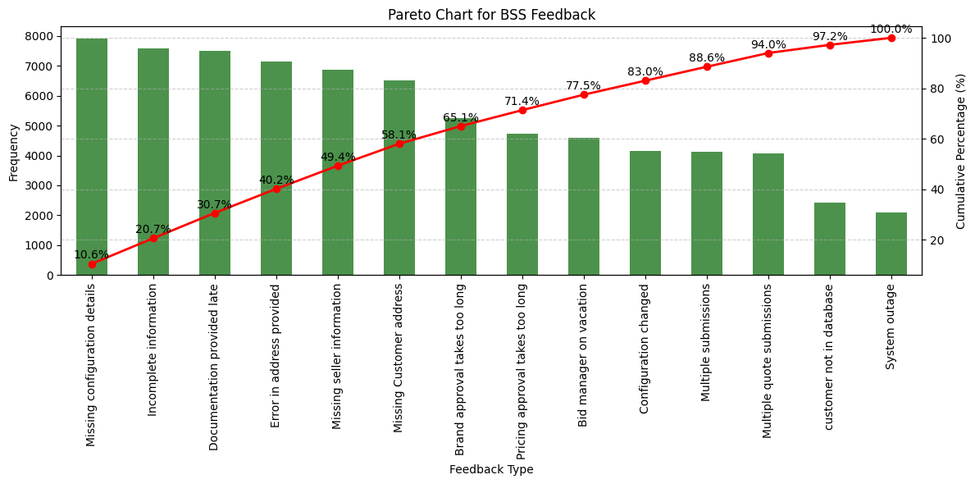
Pareto Chart for BSS: Missing Information Issues

Slide 17
Fish bone for Long Cycle Time for Gentech
People
Method
Seller Overburdened
No RPA
BSS Problems
Too many dependencies
Lack of Training
Manual checking
Red Tapism
Long
Cycle
Time
Fragmented
No visibility of bottlenecks
Informal settings
Excessive Handovers
Outdated ERP system
Time zone difference
Lack of Agile
Lack of automation
No KPIs
Sequential Processing
Machine
Environment
Method

Slide 18
FMEA (Failure Modes and Effect Analysis)
Process | Potential Failure Mode | Potential Failure Effects | SEV | Potential Causes | OCC | Current Controls | DET | RPN | Action Recommended
Cycle Time | The trader gave false rather that incomplete information. | Incorrect data, dissatisfaction | 7 | Seller's data error | 6 | Validate seller-submitted data | 8 | 336 | Default & template settings
 | The request has been sent to the incorrect BSS, causing delays. | Routing error, process delays | 6 | Routing miscommunication | 5 | Clear request routing communication | 7 | 210 | Implement clear routing guidelines and verification steps
 | Missing customer information in the request. | Missing data, processing delays | 5 | Incomplete request submission | 6 | Mandatory ERP system fields | 8 | 240 | Automate ERP system with mandatory fields
 | Delayed response from the Seller to provide required information. | Seller delay, extended process | 7 | Seller response delay | 6 | Monitor seller response time | 7 | 294 | Set seller response time expectations and track compliance
 | Errors in the technical specification generated by the Product Design team. | Spec errors, customer dissatisfaction | 6 | Design team oversight | 4 | BSS review of technical specs | 7 | 168 | Improve review process for technical specs
 | Configuration changes requested by the Seller after approval. | Change requests, rework | 5 | Seller's change requests | 5 | Defined change request process | 6 | 150 | Standardize change request handling procedures
 | Brand Manager delays in approving the pricing proposal. | Pricing approval delay | 7 | Manager approval delay | 6 | Timely pricing proposal approval | 7 | 294 | Define and enforce approval timelines
 | Incorrect terms and conditions in the final proposal document. | Legal issues, dissatisfaction | 6 | Document creation error | 5 | Document review by Proposal Manager | 7 | 210 | Enhance document review and validation procedures
 | Proposal Support Manager overlooks errors in the proposal. | Oversight, errors | 5 | Manager oversight | 5 | Regular audits and quality checks | 6 | 150 | Conduct regular quality audits and feedback
 | Proposal submission to the Seller gets delayed. | Proposal delay, missed opportunities | 6 | Submission process delays | 5 | Adhere to submission deadlines | 7 | 210 | Implement strict submission deadlines and monitoring
 | Bid Support Specialist lacks experience or expertise. | Expertise lacking, errors | 5 | Inadequate BSS training | 5 | Ongoing BSS training and development | 6 | 150 | Provide ongoing BSS training and skill development
 | Communication breakdown between the Seller and BSS during the process. | Communication issues, delays | 6 | Poor communication practices | 6 | Establish clear communication protocols | 7 | 252 | Establish and enforce clear communication protocols

Slide 19
VA/NVA Time Distribution by Process Step
Step Name | VA/NVA | Time Taken | Percent
Seller identifies opportunity (STS1) | VA | 1.2 days | 10%
Request accessed by BSS (ZQT2) | NVA | 2.3 days | 19%
BSS checks information (ZQT3) | NVA | 1.5 days | 12%
BSS reviews with Proposal Manager (ZQT4) | VA | 1.0 days | 8%
Configuration by Product Design (ZQT5) | VA | 3.2 days | 27%
Configuration reviewed by BSS (ZQT6) | NVA | 1.8 days | 15%
Seller approves configuration (ZQT7) | VA | 0.8 days | 7%
Pricing reviewed and approved (ZQT8) | NVA | 2.0 days | 17%
Final proposal reviewed and submitted (STSX) | VA | 0.5 days | 4%

Slide 20
Predicting Modelling & Sentiment Analysis for Proposal Cycle Time Optimization
Predicting Proposal Cycle Time:
Various perceptible features, like vendor experience, bidding sophistication, categories of feedback, and time stamps of every phase in the process phase, such as delivery time, offer sufficient information to develop a prediction model. Regression models, in some instances regression section experts called linear regression or random forest, would assist in setting important factors that raise the values of cycle time. In fact, other feature engineering measures (like isolating day-of-week or brand effects) might help improve prediction accuracy. Further, clustering techniques and SMOTE could help combat class imbalance issues during the anticipation of delays beyond the given SLA threshold.
Text analytics and Seller Sentiments:
The feedback provided by sellers and BSS for each transaction is summarized. Comment on how you believe Jeff could use the open-text data to extract major, insightful points about seller and BSS attitudes. You do not have to perform the analysis, but you can describe methods to extract knowledge from text-based data.

Slide 22
Optimizing Gentech's Proposal Creation Process: Strategic Recommendations Using McKinsey's 7S Framework
7S Element | Issue | Recommendation | Action Plan
Strategy | High cycle times due to complex and redundant processes. Manual tasks slow down the proposal process | Invest in automation and AI-driven tools Implement a tiered proposal process | Create fast-track processes for critical bids Deploy RPA (Robotic Process Automation) for repetitive tasks, reducing manual workload. Implement self service portal for bids below 30,000
Structure | Excessive hand-offs Inconsistent practices - across geographies Limited visibility into process bottlenecks. | Restructure BSS teams to dedicate account managers Establish standard operating procedures (SOPs) | Pilot an account-based BSS structure for key clients. Create SOPs and templates, Deploy dashboard tools
Systems | Lack of Modern ERP | Introduce workflow automation software and ERP | Use automation software to handle repetitive verification and approval tasks. Establish an auto-prioritization system for complex proposals.

Slide 23
Optimizing Gentech's Proposal Creation Process: Strategic Recommendations Using McKinsey's 7S Framework
7S Element | Issue | Recommendation | Action Plan
Shared Values | Culture focused on cost reduction rather than client satisfaction and speed | Shift focus toward a client-centric, efficiency-focused culture with clear efficiency goals. | Communicate the strategic importance of cycle time reduction. Reward efficiency and client satisfaction in the performance review and compensation structure.
Style | Leadership focused on cost control rather than agility and speed. | Encourage leaders to adopt an agile mindset | Provide agile leadership training.
Staff | BSS teams have varying skill levels | Create specialized roles within BSS for high-value bids | Implement training programs Develop a mentorship program pairing
Skills | Inconsistent skill levels | Conduct a skills assessment and provide targeted training | Quarterly skills assessments. Offer workshops on advanced configurations.

Slide 24
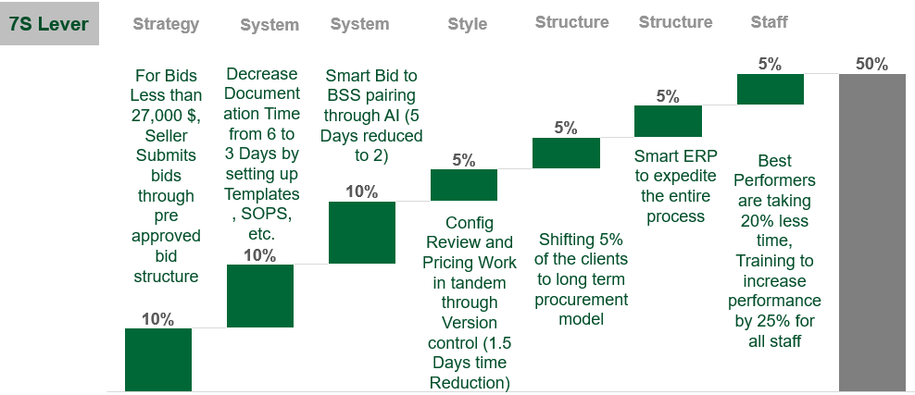
Roadmap to 50% Reduction in Bid Processing Time
Self Service Portals for Sellers
Knowledge Management
Smart BSS Pairing
Agile Process
Long Term Contracts with Clients Instead of Single Bids
New ERP
Staff Training
Total

Slide 25
Control Plan for Gentech
Control Element | Description | Expected Outcome
Training for BSS/Staff | Continuous Investment in Training Proficiency in AI and ERP Tools Regular Skills Assessment | Increased Proficiency in using new tools, improved efficiency and reduced cycle time.
Escalation Protocols | Develop clear escalation protocols to address issues | Timely resolution of issues, ensuring minimal impact on cycle time and process flow.
Dedicated Improvement Team | Establish a team focused on ongoing process improvement and data analysis | Continuous identification of improvement opportunities, keeping the process aligned with strategic goals.
Periodic Reviews | Schedule regular reviews at the management level | Assurance that improvements are aligned with company goals, fostering a culture of continuous improvement.

Slide 26
Thank You!

